Slide 1







MeshCentral
HARDWARE TLS
Built with modern web technologies

Slide 2
Review of MeshCentral
Download & Stats
State of Social Media
Overview
Hosting Cost
Android
macOS
Security
Intel® AMT
Features

Slide 3
Downloads & Stats

Slide 4

MeshCentral
1.2 million
downloads on NPM
1.4 million
downloads on Docker Hub
*
MeshCentral has had significant download increase in the past years.
In 2020, MeshCentral seems to have gotten a significant COVID bump.
Data from npm-stats.com obtained on 12/11/2020.

Slide 5

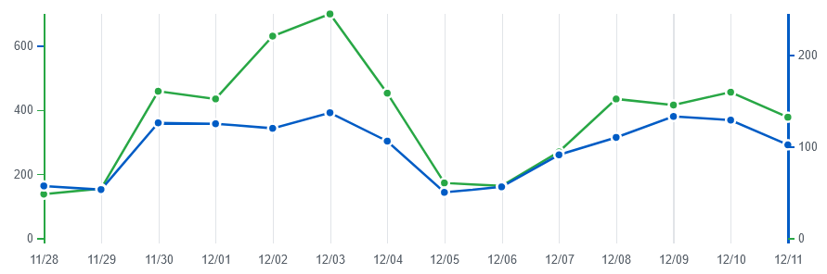
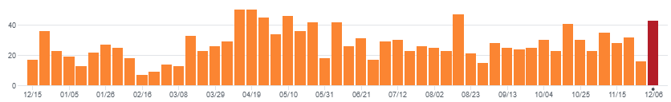
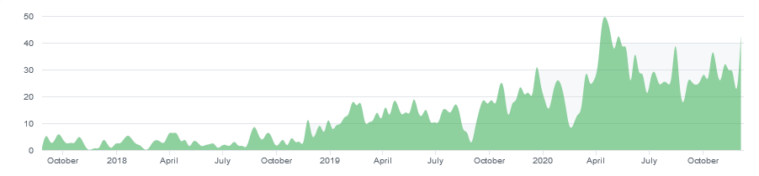
GitHub Daily Visits
GitHub stats just for the MeshCentral server. Total GitHub traffic is higher since MeshAgent, Router and Assistant are not included.
Views
Unique Visitors
GitHub Commits per Week
From 50 to 130 unique visitors a day visit the MeshCentral GitHub site.
Contributions to MeshCentral
The number of commit to MeshCentral has been fairly consistent throughout the year.
The number of GitHub commits has increased significantly in 2020.
Data from GitHub.com obtained on 12/11/2020.

Slide 6
State of Social Media

Slide 7
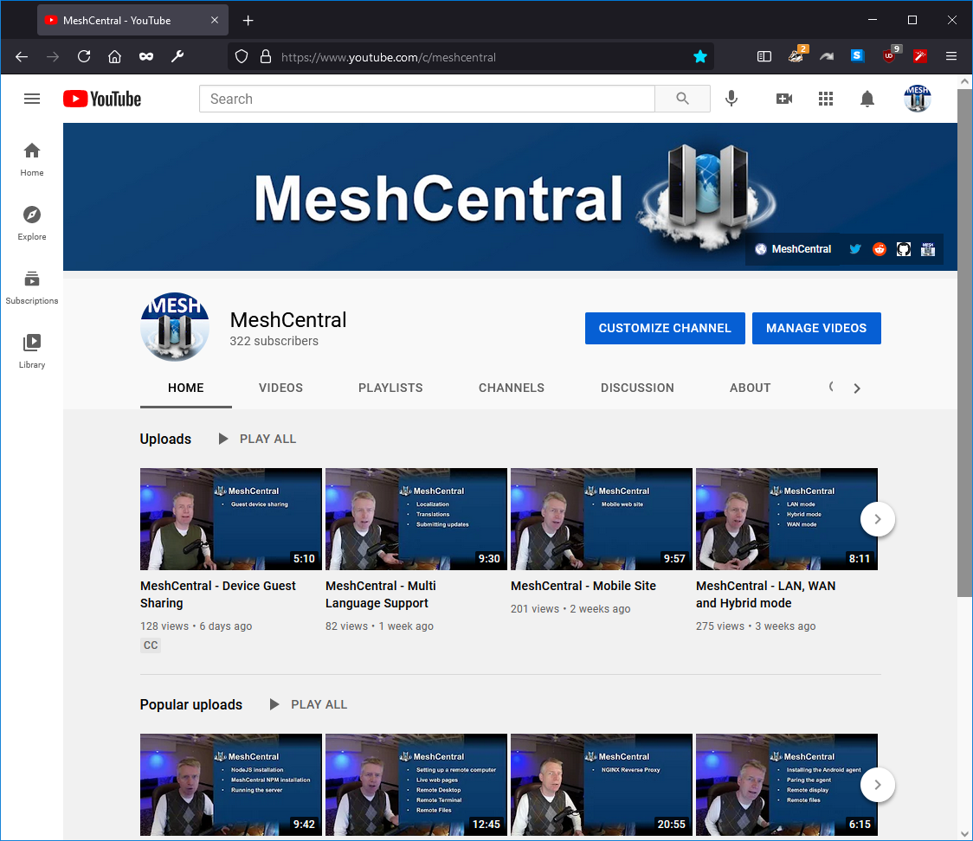
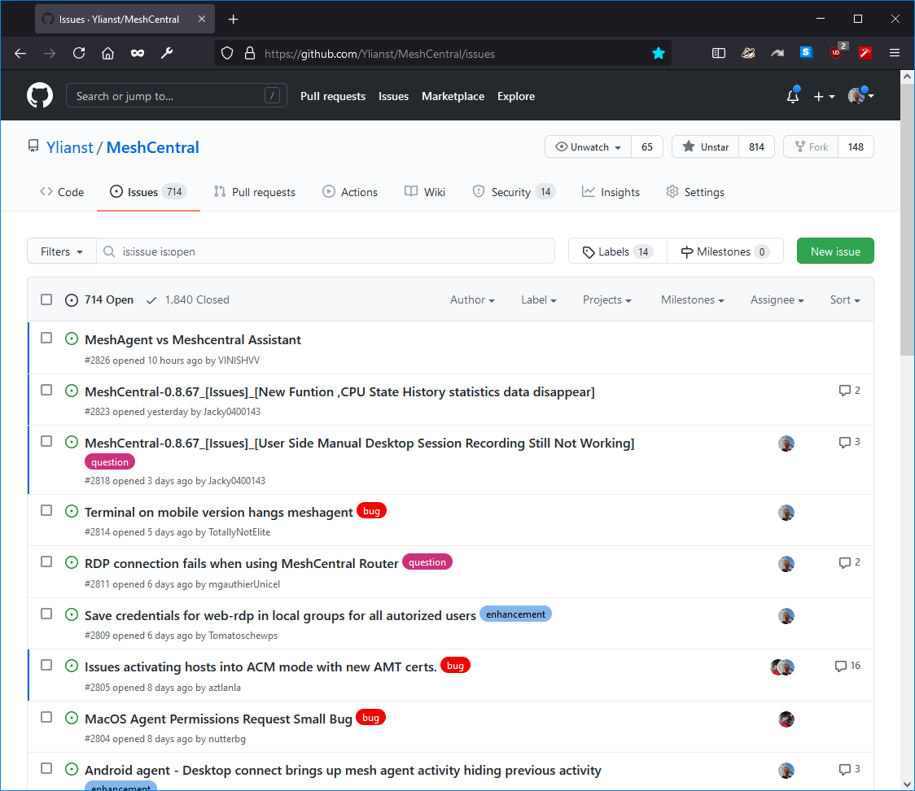
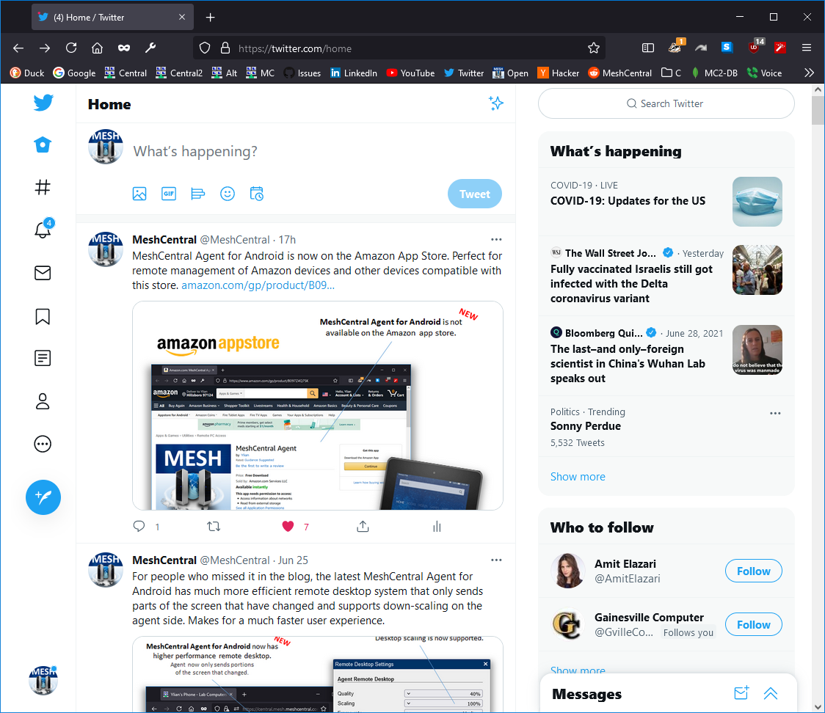
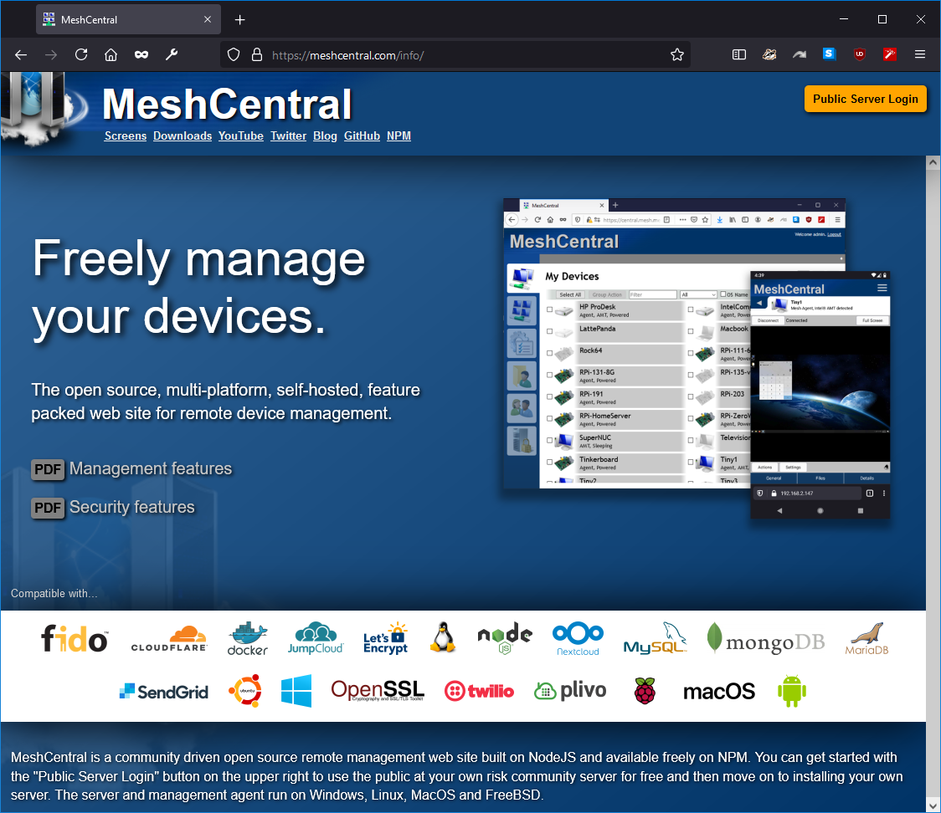
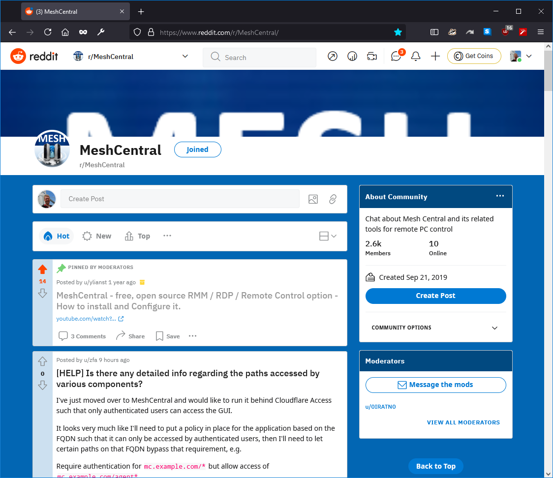
YouTube channel /c/meshcentral
GitHub Issues
Twitter
MeshCentral.com
Reddit /r/meshcentral

Slide 8
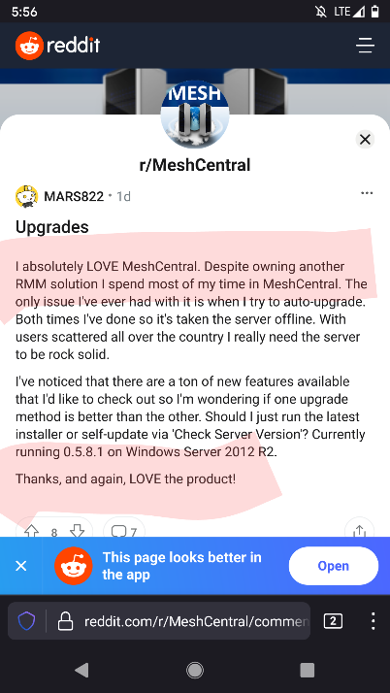
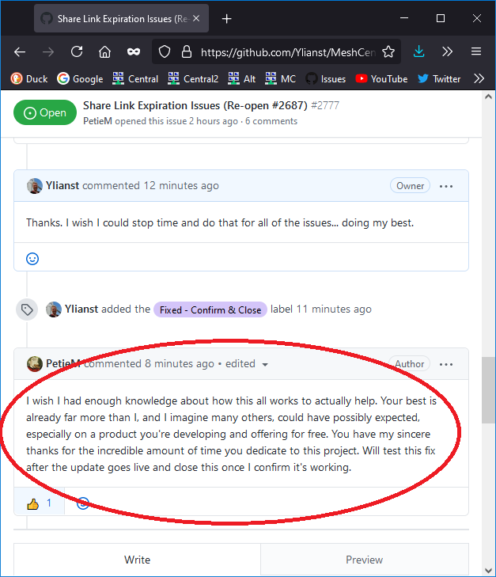
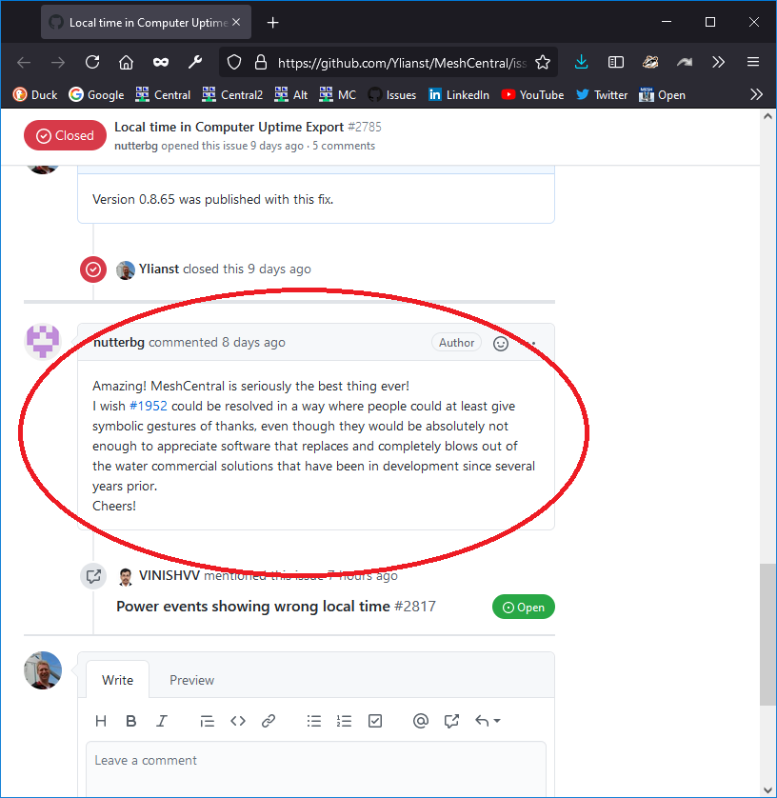
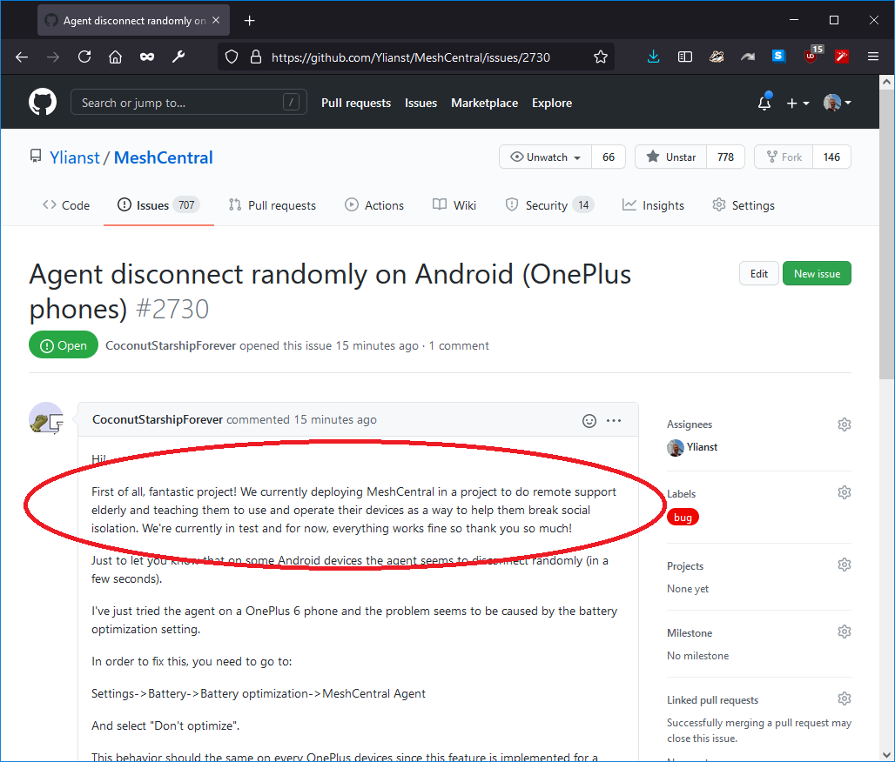
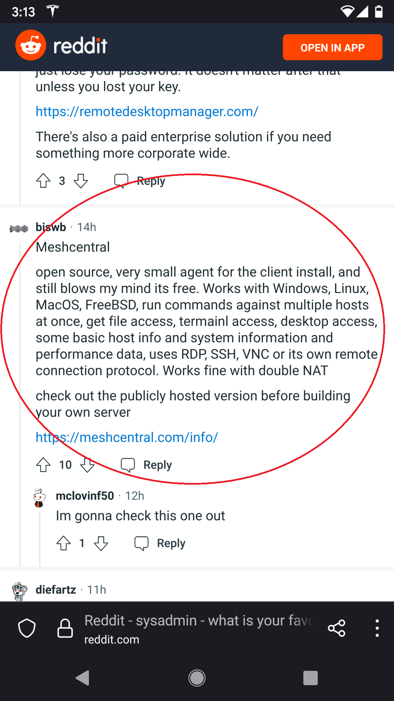
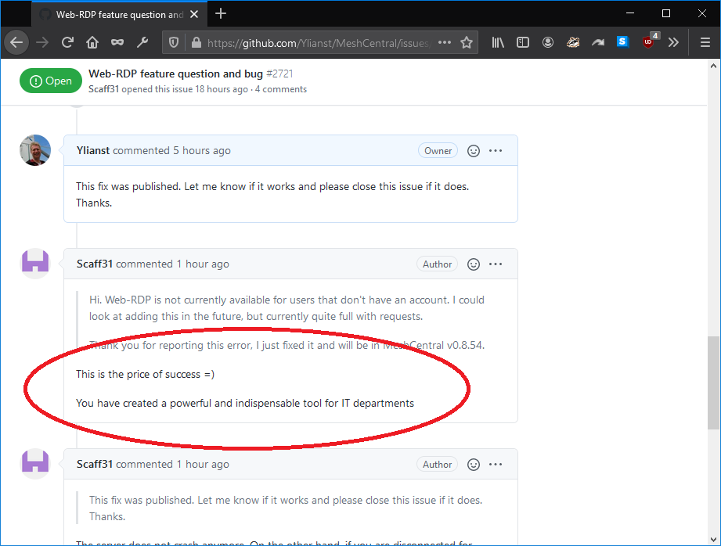
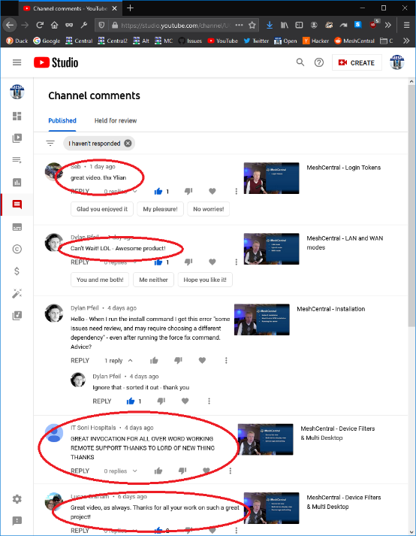
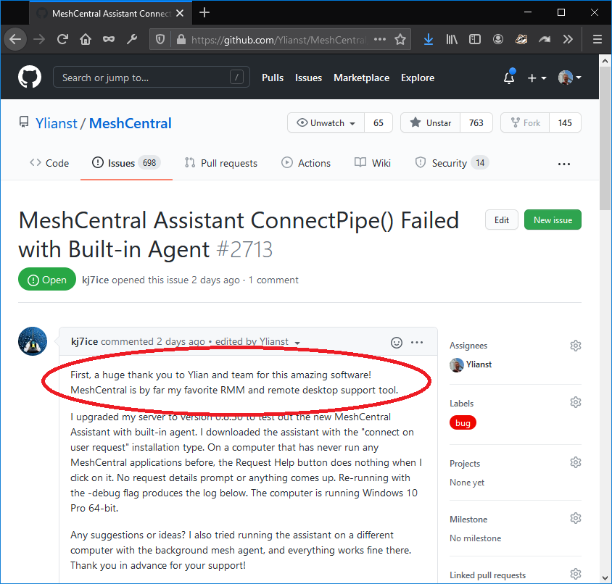

Slide 9



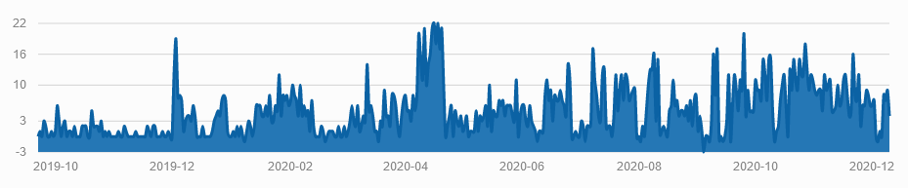
Data from analytics.twitter.com obtained on 12/11/2020.
MeshCentral Twitter Channel Visits
Daily subscribe growth on Reddit /r/MeshCentral
From November 14th to December 11th, the MeshCentral Twitter got 24.3k impressions, or 869 impressions a day.
Data from frontpagemetrics.com obtained on 12/11/2020.
MeshCentral Reddit now has 2183 subscribers and now ranks in the top 10% of subreddits.

Slide 10

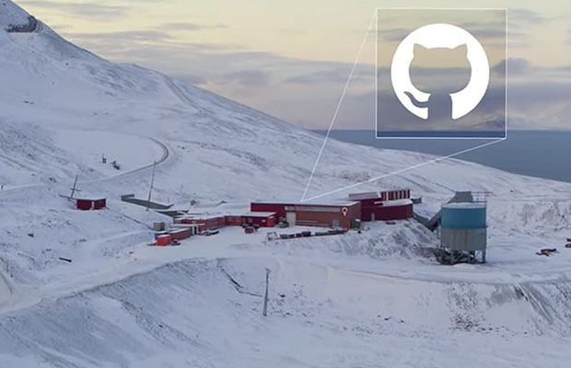

MeshCentral, MeshAgent and MeshCentral Router have been selected by GitHub to be printed on archival film for long term storage in the artic.
Located next to the global seed vault, the MeshCentral code should last 1000 years.

Slide 11
MeshCentral Overview

Slide 12
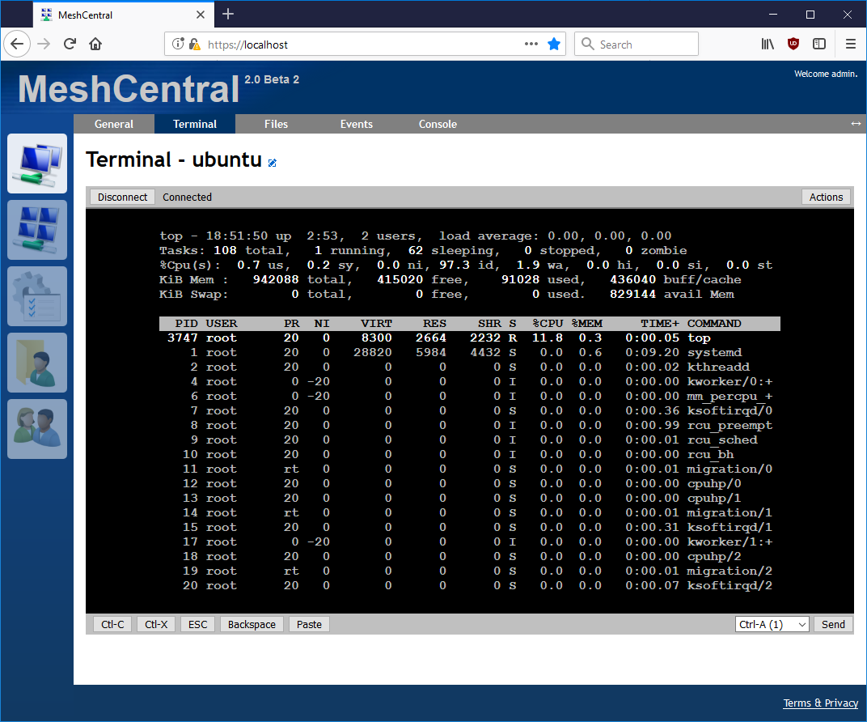
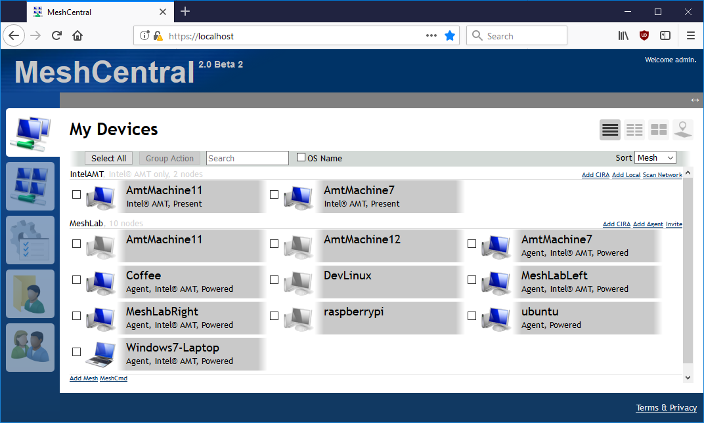
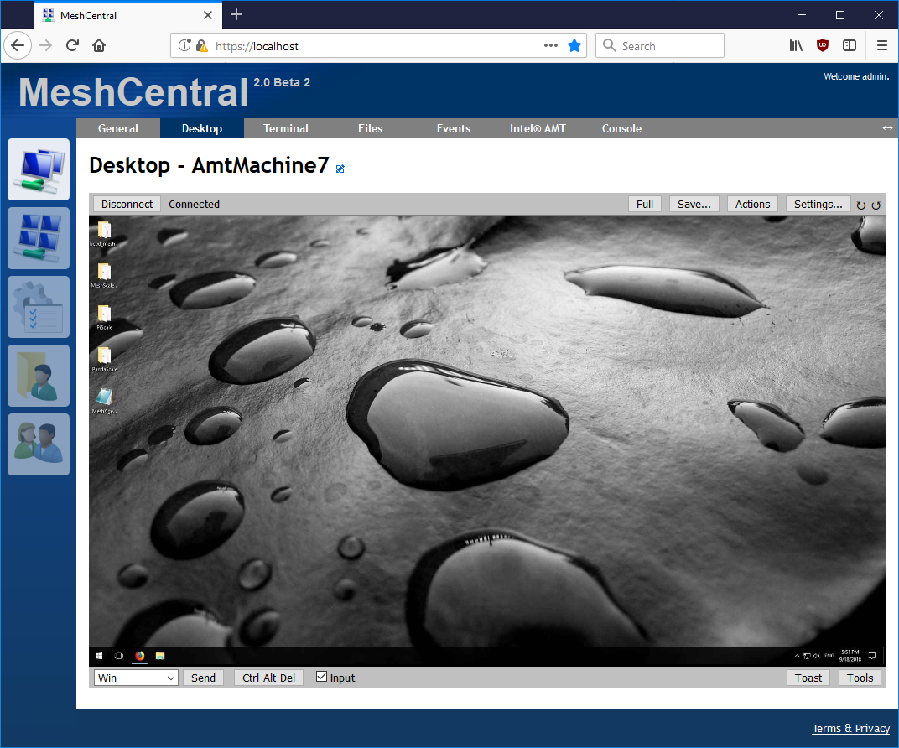
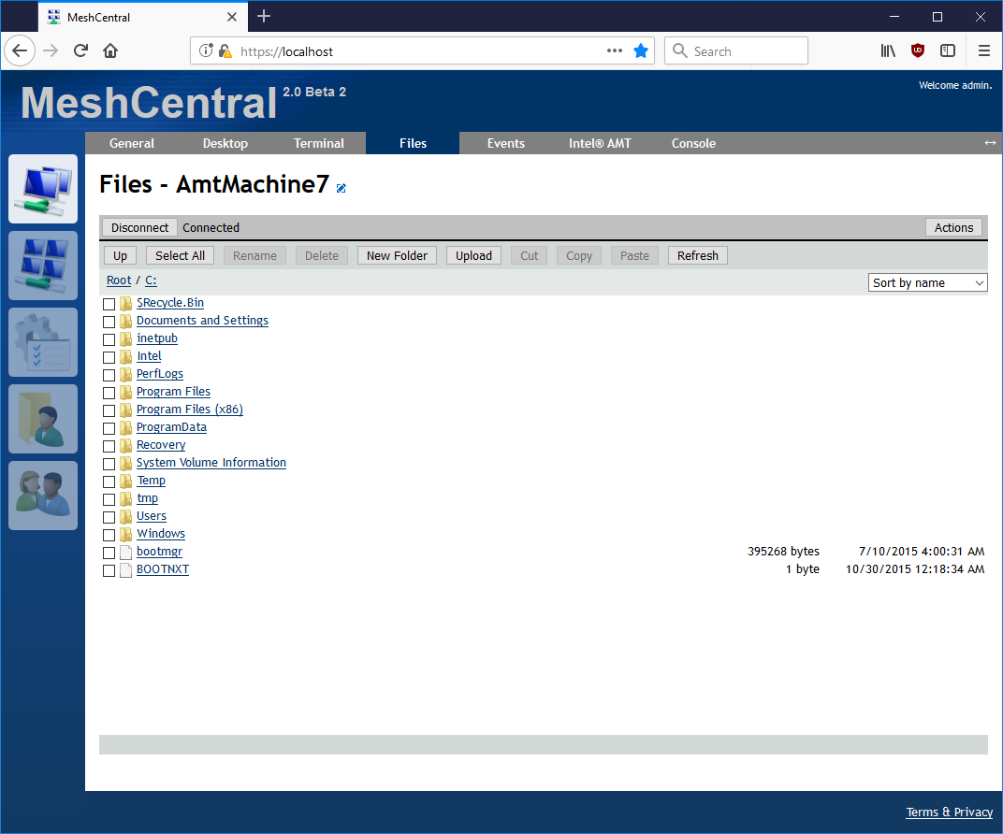
MeshCentral
Remote desktop
Remote Files
Remote Terminal
Device information
Real-time user interface
LAN / WAN / Hybrid modes

Slide 13
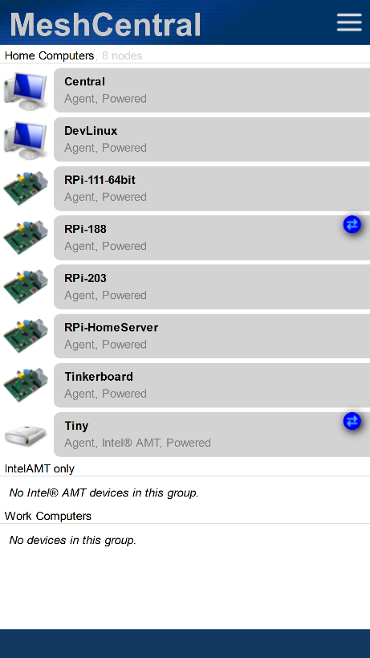
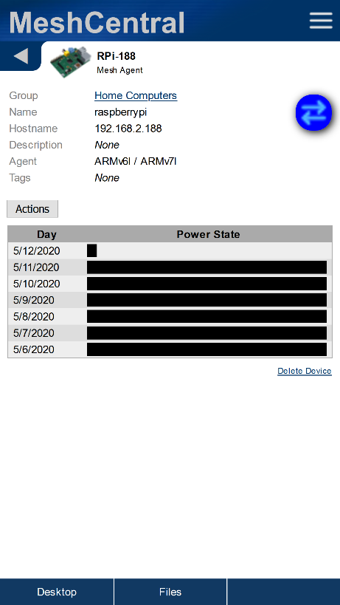
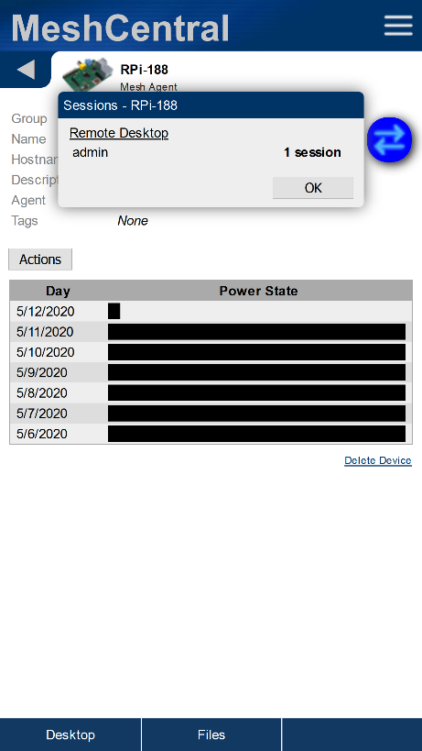
NEW
A blue icon is now shown on the mobile application for devices that have one or more active remote management sessions.
Tap the icon to see what remote management sessions are active.
Icons are real-time, no refresh required.

Slide 14


MeshCentral
Deploy Fast
Deploy to Linux & Windows.
Supports Docker.
“npm install meshcentral”

Slide 15





MeshCentral
Deploy Anywhere
Standalone, appliance or cloud.
AWS, Google, Azure.
®
®
®
®

Slide 16



Scale More
With Server Peering, MongoDB and TLS Offload.
HARDWARE TLS
MeshCentral

Slide 17



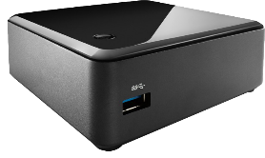
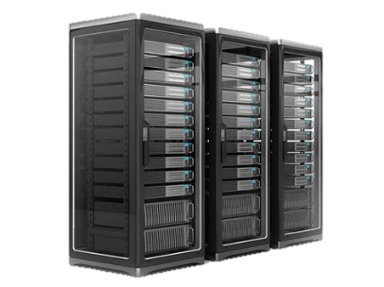
2
MeshCentral
mesh.org.com
files.org.com
www.org.com
Private IP address
y.y.y.1
Reverse Proxy
File Server
Public IP address
x.x.x.x
Private IP address
y.y.y.2
Ports 80 and 443
are shared.
Web Server
mesh.org.com
Private IP address
y.y.y.3

Slide 18
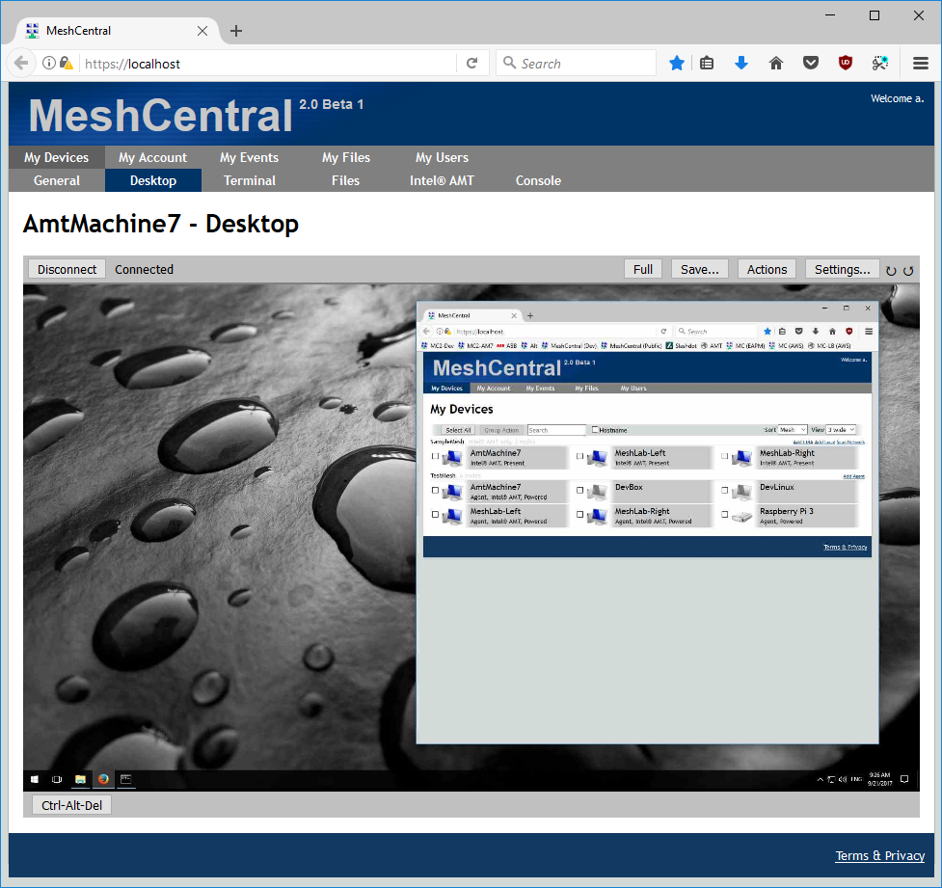
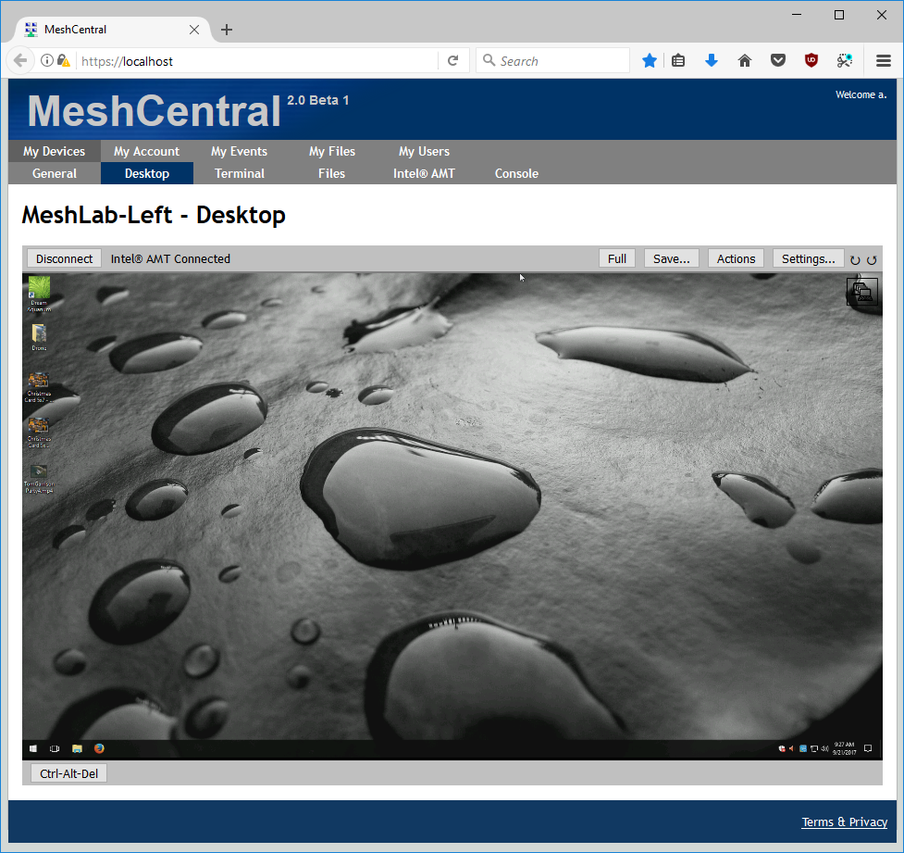
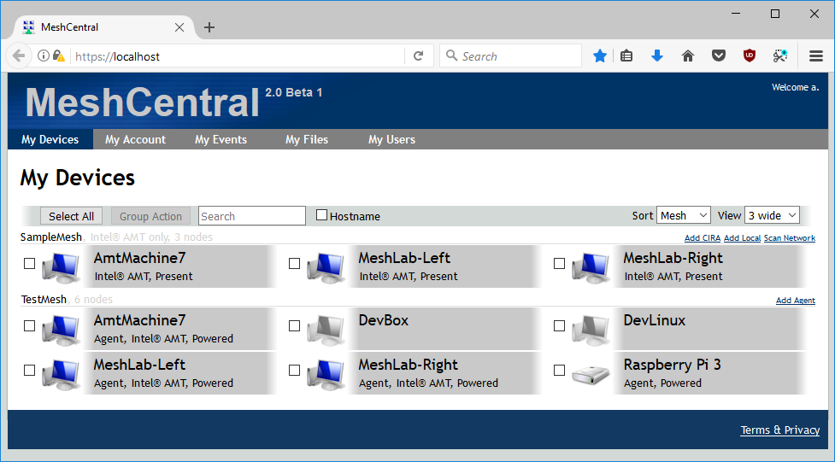






Mesh Agent² Soft-KVM
Intel® AMT Hardware KVM
Perform software and hardware remote desktop sessions to computers on both servers.
Server Peering
TLS / Web Socket
Users connected on either server see a real-time combined view of both servers.
All connections except for Intel® AMT CIRA are secure web socket on port 443.
2
2
MeshCentral
MeshCentral
Intel® AMT CIRA
Intel® AMT CIRA
Mesh Agent
Mesh Agent

Slide 19
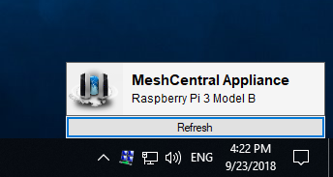
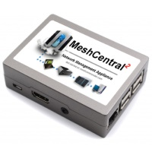
WAN Mode Server must have a fixed DNS name.
Perfect for Internet deployments.
LAN Mode No fixed server IP or name.
Perfect for local networks.
MeshAgents & Intel® AMT connect to the server
at a know IP/name
Server can connect
directly to Intel® AMT
Mesh Agents multicast
on the LAN to find
the server.

Slide 20



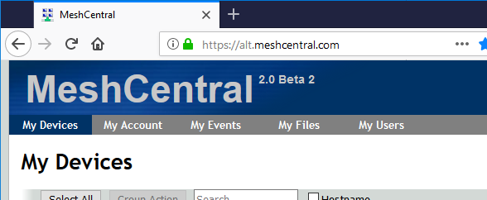
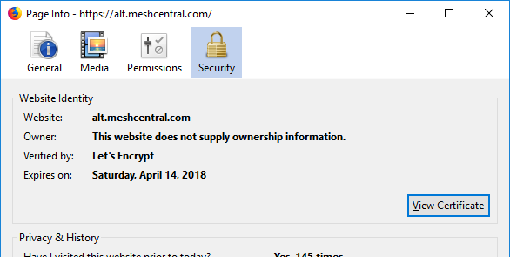
MeshCentral
Register
Prove domain control HTTP:80
Get HTTPS certificate
meshcentral-data
letsencrypt
…
Let’s Encrypt files and certificates will be located in the data folder.

Slide 21


NEW
Starting with MeshCentral v0.7.47, many MongoDB transactions are groups into bulk reads and bulk writes.
MeshCentral
WRITE
OK
WRITE
OK
Before v0.7.47
WRITE 1
WRITE 2
WRITE 3
OK
v0.7.47 and after
This leads to much better database performance and server scaling as fewer round trips to the database are performed.

Slide 22





MeshCentral
Now with multiple back-end database support
MeshCentral now supports any one of four back-end databases making it easy to deploy MeshCentral on your existing infrastructure.
Easy setup by configuring the database using “MongoDB”, “MariaDB”, “MySQL” or nothing for NeDB in the MeshCentral configuration file.
NEW
{
"settings": {
"port": 443,
"MariaDB" : { "host": "localhost", "user": "", "password": "" },
"MySQL" : { "host": "localhost", "user": "", "password": "" },
"MongoDb": "mongodb://127.0.0.1:27017"
}
}
IN TESTING
NEW
Config.json
IN TESTING

Slide 23
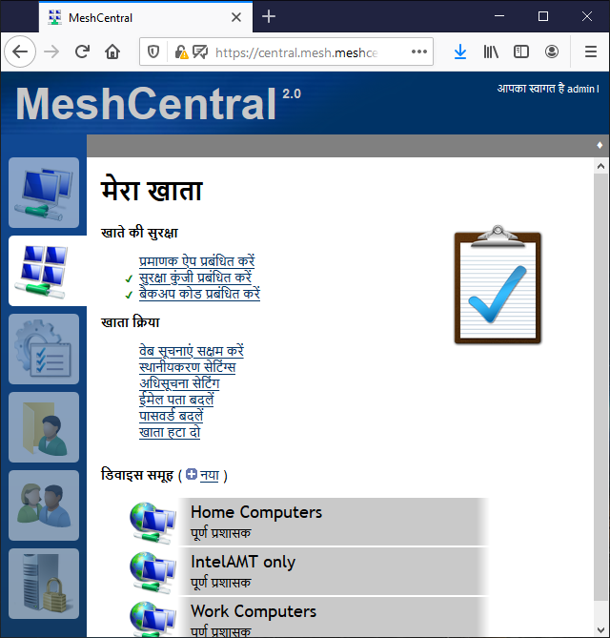

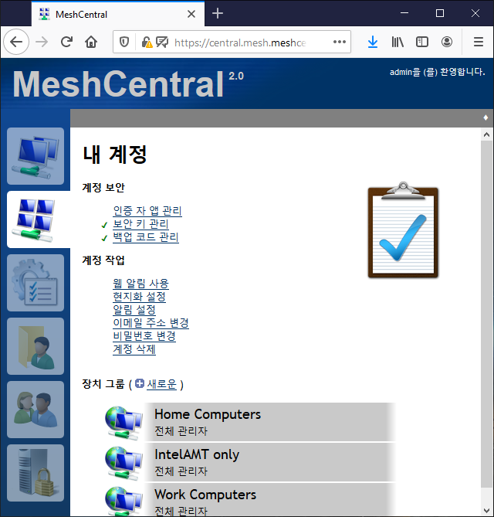

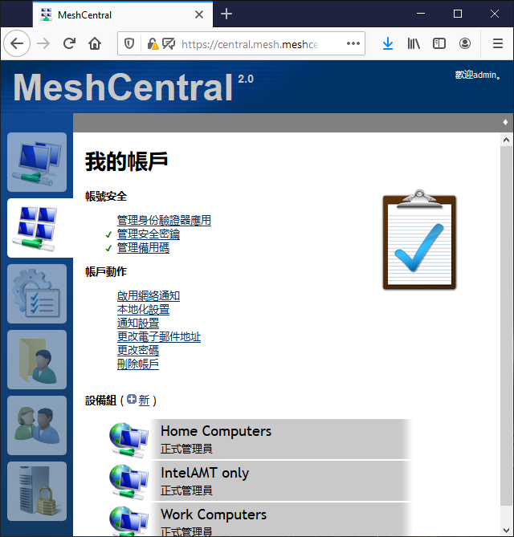

Translated in 15 languages
English
Czech
German
Spanish
Finnish
French
Hindi
Italian
Japanese
Dutch
Portuguese
Swedish
Turkish
Chinese (Simplified)
Chinese (Traditional)

Slide 24
MeshCentral Hosting Cost

Slide 25
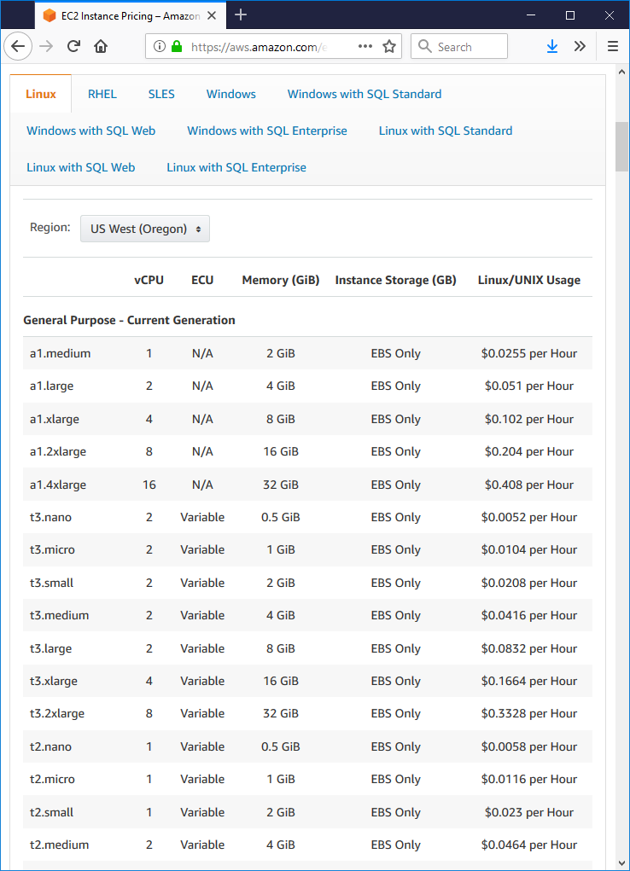
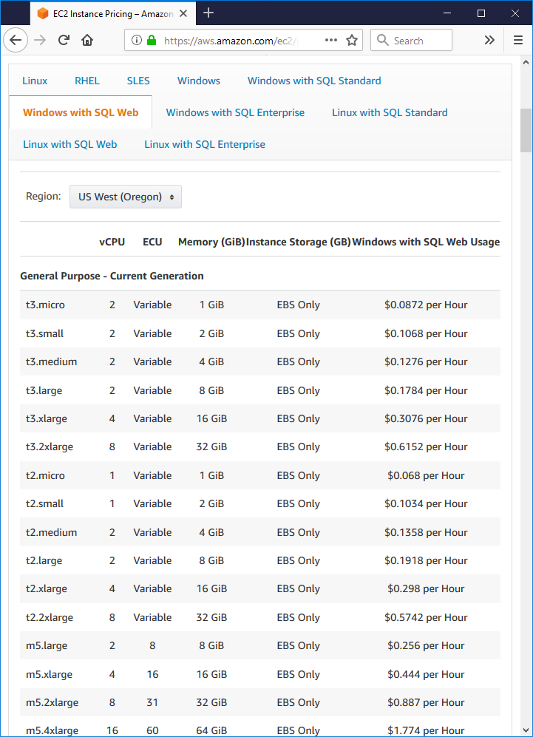
MeshCentral v1
MeshCentral
Basic SQL license
63 $ / mo Not usable?
221 $ / mo
~1000 devices
15 $ / mo ~1000 devices

Slide 26
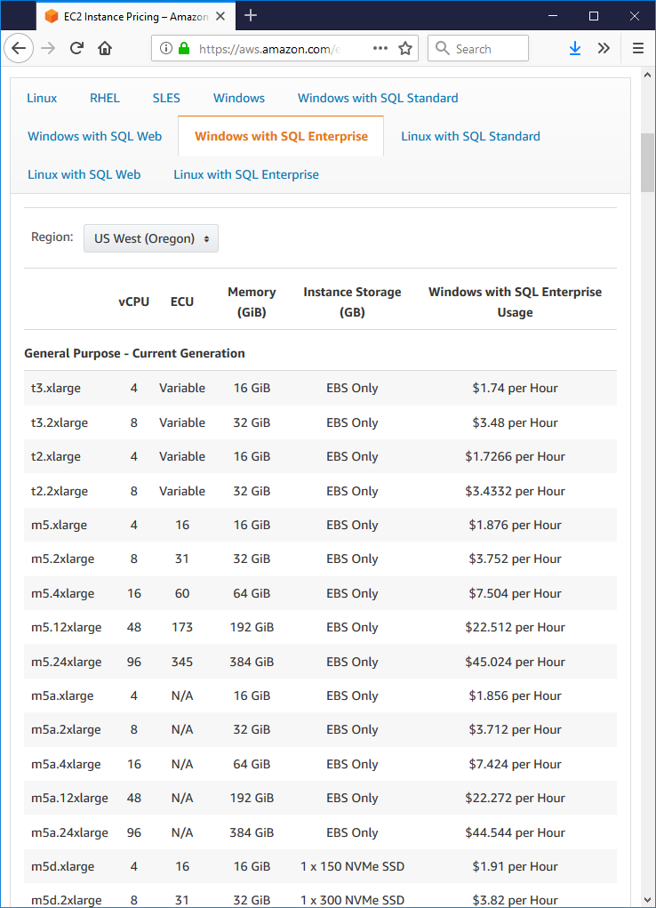
MeshCentral v1
MeshCentral
Needed to scale
239 $ / mo This is a big instance
1243 $ / mo Absolute Minimum

Slide 27


By activating MeshCentral and MeshAgent new compression features, significant hosting costs reductions can be achieved.
NEW
The MeshAgent now includes ZIP and Deflate compression and decompression support.
MeshCentral
NEW
Agent Update Compression
Web Page Minification and Compression
NEW
JavaScript Code Compression
NEW
NEW
Agent
Browser
WebSocket Compression
WebSocket Compression
ZIP + Deflate
Module
The MeshCentral server can now compress WebSocket traffic to and from both browsers and agents.

Slide 28

MeshCentral
By updating to the latest MeshCentral, agent updates will now be compressed. At the AWS outbound cost of 0.09$ a GB, a single update of 10000 devices will now cost almost 2$ less.
 | Actual (Bytes) | Compressed (Bytes) | GB Saved (10000 devices) | Savings (US Dollars)
Windows Mesh Agent | 3292696 | 1609296 | 16.83 | $ 1.52
Linux Mesh Agent | 2910744 | 1493443 | 14.17 | $ 1.28
Windows Mesh Core | 414941 | 88439 | 3.27 | $ 0.29
Linux Mesh Core | 386079 | 81414 | 3.05 | $ 0.27
Compressed agents and meshcores reduce traffic costs by more than half, increase update speed, reducing server load and improving server scalability.

Slide 29
All modern browsers support WebSocket compression as per RFC7692. By enabling it on the MeshCentral server, significant browser-to-server cost reduction can be achieved.
Now, the MeshAgent also supports RFC7692 WebSocket compression, so that agent-to-server traffic can also be compressed achieving more costs savings.
MeshCentral
WebSocket Compression
WebSocket Compression
Agent
Browser
ZIP + Deflate
Module
Activate server and agent side WebSocket compression like this.
We have seen a 10% to 20% compression ratio on remote desktop traffic. This alone should reduce hosting costs significantly.
{
"settings": {
"WsCompression": true,
"AgentWsCompression": true
}
}
config.json

Slide 30
MeshCentral
Web Page Minification and Compression
{
"settings": {
"Minify" : true,
"Compression": true
}
}
Browser
config.json
 | Size (MB)
Original | 3.91
Minified | 2.67
Compressed | 1.05
Minify + Compressed | 0.9
Activating MeshCentral web page minification and compression provides additional speed and reduction in hosting costs.

Slide 31
MeshCentral on Android

Slide 32

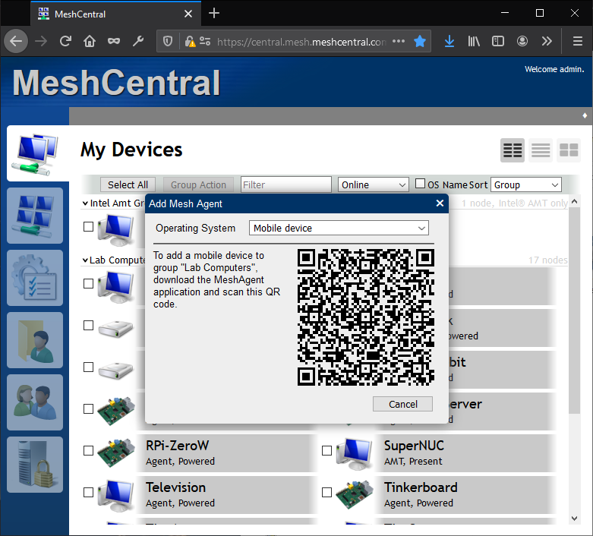
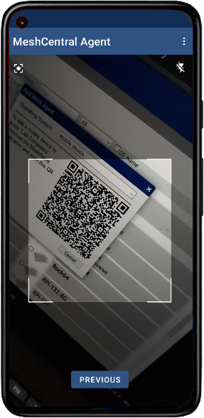
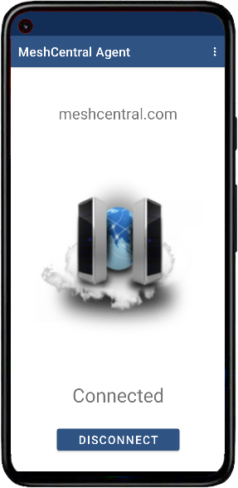
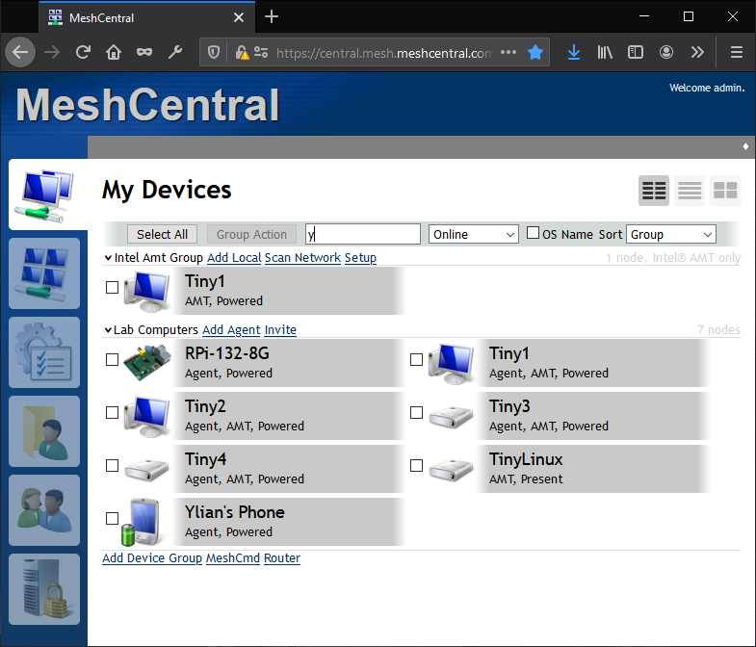
1
On your Android device, download the “MeshCentral Agent” application from the Google Play store.
2
Use the applications built-in QR code scanner to scan the QR code on your MeshCentral server to pair the device.
3
Once paired, hit the connect button to connect your device back to the server.

Slide 33

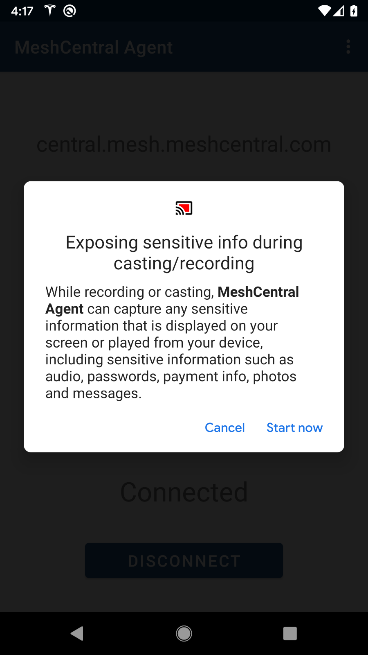
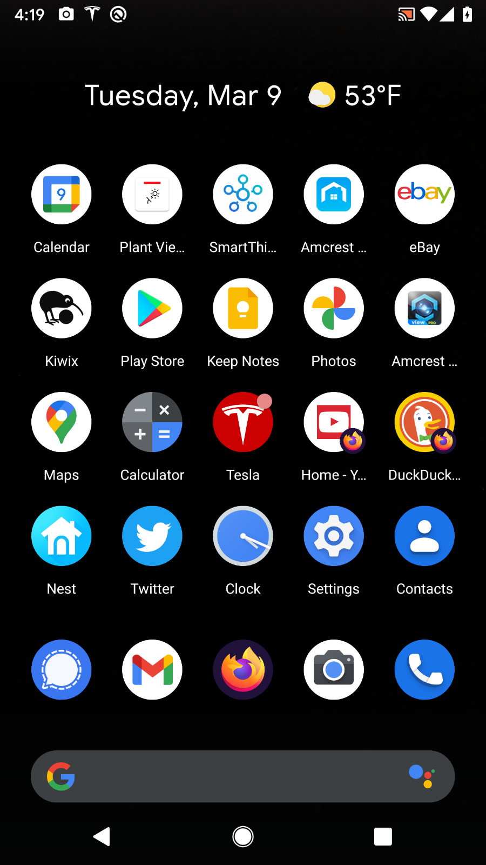
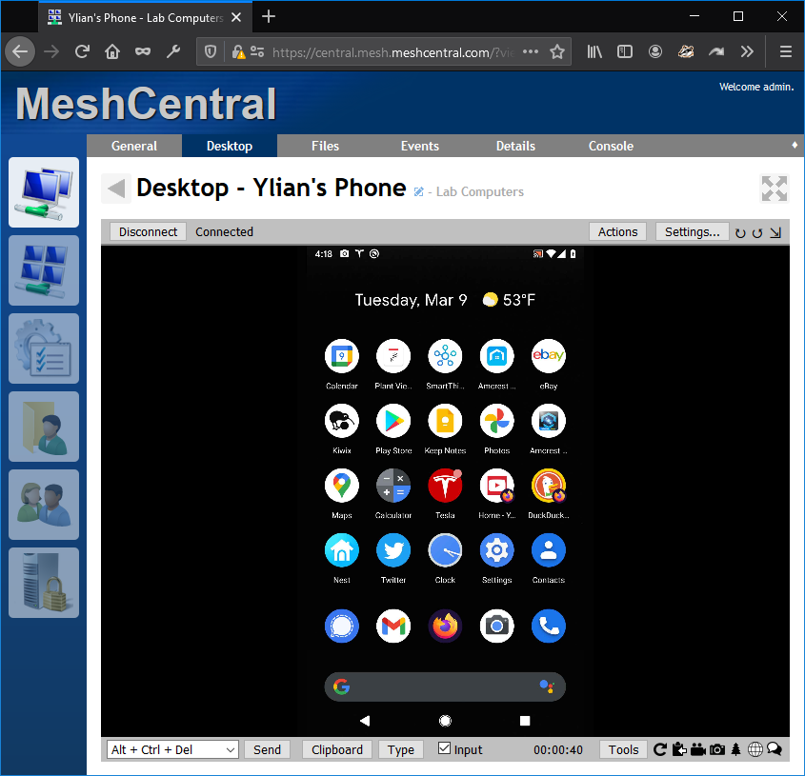
NEW
MeshCentral Agent for Android now supports remote desktop view
Hit “Connect” on the desktop tab, Android agent will display a user consent prompt.
Once approved, MeshCentral will display the screen from the Android device.
No remote input is allowed, MeshCentral can only view the remote screen.

Slide 34
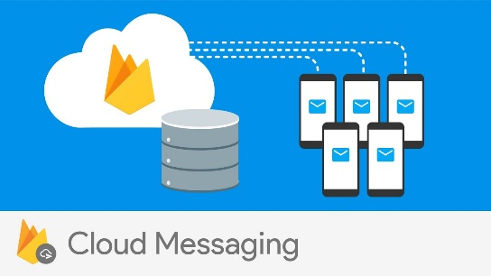
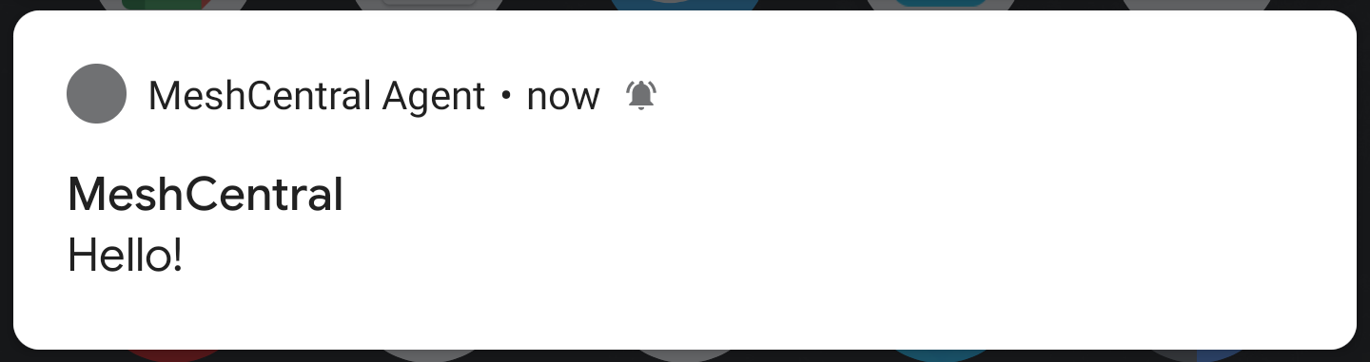
Firebase Cloud Messaging
3
Pair a Android device with your private MeshCentral server.
myserver.com
1
Notifications will show up on the device.
MyServer
MeshCentral Instance
MeshCentral.com
{
“settings”: {
“PublicPushNotifications": true
}
}
2
Use the free push notification service offered by MeshCentral.com and Firebase to send messages to the Android device anytime.
config.json

Slide 35

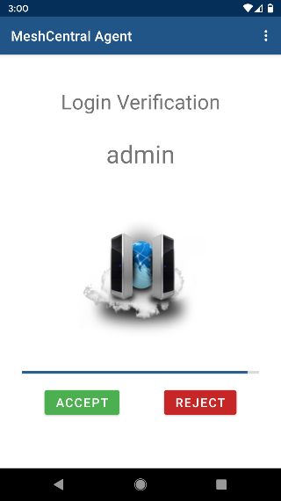
3
The approval or rejection of the login request is sent directly to the paired server.
2
Notifications are sent to Firebase that relays it to the device.
MyServer
MeshCentral Instance
MeshCentral.com
{
“settings”: {
“PublicPushNotifications": true
}
}
1
Servers use the public MeshCentral.com server to send push notifications.
config.json

Slide 36
MeshCentral macOS

Slide 37


MeshCentral is tested to work on Big Sur, for both Intel x86 and Apple Silicon processors.
MeshCentral
Starting with Big Sur, you only need to grant MeshAgent permissions on first install. Agent updates will keep permissions.

Slide 38



NEW
The MeshCentral Agent for macOS is now compiled natively for Apple Silicon.
First install uses the universal binary. For updates, the server will send the exact x86 or ARM binary.
MeshCentral
Intel x86-64 Binary
Apple Silicon Binary
The universal binary contains both Intel x86-64 and Apple Silicon executables.
MeshCentral also has the Intel x86 and Apple Silicon binaries as separate files for efficient agent updates.

Slide 39
MeshCentral Security

Slide 40

Highlights the
top 12 MeshCentral
security features.

Slide 41


NEW
IOActive was contracted to perform a security review of MeshCentral.
MeshCentral
The review occurred with server and agent source code from June 15th to July 17th 2020.

Slide 42



MeshCentral has been tested to work with CloudFlare.
The HTTP headers added by CloudFlare proxies are processed by MeshCentral
MeshCentral
HTTP
Agent
AMT
{
"settings": {
“TrustedProxy":“CloudFlare"
}
}
NEW
config.json
MeshCentral can now load the list from trusted proxies directly from CloudFlare.

Slide 43


NEW
You can now set user consent options in a user group. Users that have rights over devices thru user group will have these consent flags apply when connecting to a device.
Consent
Policy
Consent
Policy
User Group
NEW
Consent
Policy
Consent
Policy
Device Group
Consent
Policy
User consent policy can be set server-wide, per-user, per-device group, per-device and now per-user group.
Consent policy indicates how remote users are prompted and/or notified when a connection is made to a remote device.

Slide 44





MeshCentral now supports 5 different second authentication factors.
MeshCentral
Time Codes
Email code
One time codes
Touch ID
FIDO Hardware Keys

Slide 45



2
Use Google Authenticator
to scan the QR code.
1
In the “My Account” tab, click on “Add 2-step login”.
3
Enter the time token back into MeshCentral to complete setup.

Slide 46




NEW
MeshCentral new supports FIDO keys with security PIN for two-factor authentication.
Register a key
2FA key login

Slide 47



NEW
Built-in support for both Twilio and Plivo.
MeshCentral can now be configured with a SMS gateway service to send short messages to mobile phones.
MeshCentral
Config.json for Twilio
SMS
"sms": {
"provider": "twilio",
"sid": "AC0000000000000000000",
"auth": "00000000000000000000000",
"from": "+15555555555"
}
"sms": {
"provider": "plivo",
"id": "xxxxxxx",
"token": "xxxxxxx",
"from": "15555555555“
}
Short messages can be used for login authentication or important notifications.
Config.json for Plivo

Slide 48
MeshCentral Intel® AMT

Slide 49
NEW
New MeshCentral WSMAN stack is
capable of both TLS and non-TLS traffic with all transport methods.
MeshCentral as a new Intel® AMT manager that can communicate to Intel® AMT thru for different routes.
LAN, CIRA, LMS, Relay
MeshCentral
LMS-CIRA
TLS first
MeshAgent
Intel® AMT Manager
CIRA
Non-TLS first
Relay
(Future)
LAN Traffic
TLS first
Relay-CIRA
TLS first
CIRA always uses TLS, so non-TLS traffic is preferred within this channel.
Local network traffic is only available when MeshCentral is in “LAN mode” or “Hybrid mode”.

Slide 50

The new Intel® AMT management system inside MeshCentral is capable of activating, configuring and using hardware management that is built into some Intel platforms.
MeshCentral
Current Manager Capabilities
Determine Intel® AMT state
Find user/pass from a list
Pull hardware inventory
Sync Intel® AMT clock
Power state polling
Setup Intel® AMT TLS
Setup / Remove CIRA
Activate / Deactivate CCM
Activate in ACM using cert
Setup WIFI profiles
Setup KVM and user consent
Intel® AMT Manager
Intel® AMT
As MeshCentral evolves, capabilities and features of this module will keep being improved.

Slide 51


NEW
Fully automatic policy for handling Intel® AMT. Take full advantage to hardware manageability without needing to know any of the details. MeshCentral will make all the decisions to maximize use of it.
FULL AUTOMATIC
Once enabled, MeshCentral will automatically activate Intel® AMT, setup TLS, KVM, redirection ports, user consent, sync the clock and enabled CIRA if needed.
Use both software and hardware agents to manage your devices.
Click Intel® AMT in the device group.
MeshAgent
Intel® AMT

Slide 52


MeshCentral can now create a setup.bin file to active Intel® AMT into Admin Control Mode (ACM).
MeshCentral automatically detects the root certificate is loaded and perform AMT activation.
3
ACM Activation
Boot on device and hit “Y”
2
Once this file is placed in the root folder of a FAT USB key, you can load the MeshCentral root certificate on many Intel® AMT devices.
1
Create the key

Slide 53
MeshCentral Assistant

Slide 54




MeshCentral
Assistant
The all new MeshCentral Assistant is a Windows tool that monitor and manage the MeshAgent and can be used to request help.
Right-click on the tray icon to perform quick operations.
Click on the “Request Help” button to notify the MeshCentral server that help is needed.
MeshCentral Assistant runs on the Windows tray icon bar and monitors the state of the MeshAgent.

Slide 55

NEW
MeshCentral Assistant now has it’s own built-in agent code and can connect directly to MeshCentral when requested by the user.
MeshCentral Assistant
System Tray
User Interface
MeshCentral
Build-in Agent
Remote User Support
Background
MeshAgent
Remote Device Management
MeshCentral Assistant will connect to and monitor background MeshCentral Agents.
MeshCentral can be used for device management and on-demand user support.

Slide 56
MeshCentral Features

Slide 57


NEW
MeshCentral Router for macOS allows users to map TCP ports across networks thru the MeshCentral server.
“Map my local TCP port 888 to this remote computer’s port 80.“
Both TCP normal port maps and relay port mappings are supported. You can, for example, SSH to a remote computer or access a home router’s web page.
“Map my local TCP port 888 to IP address 192.168.1.1 going thru this remote computer.“

Slide 58


NEW
The multi-desktop view now has both fixed width and variable width views.
In variable width view, device with multiple monitors will show up very wide.
Fixed width mode makes for easy device organization, but the display aspect ratio is distorted.
An Android phone is narrow as expected.

Slide 59



Once connected, WebRTC will be setup for direct browser-to-browser connection.
In addition to file transfer
if WebRTC is successful,
the audio/video icons will appear.
Local and remote windows show the chat session in real time.
Once received, click on the file to save it on the local computer.
Drag & drop a file to send it over.

Slide 60



NEW
You can now click the record icon to record the remote desktop session to a local file.
/player.htm
Play back using the MeshCentral web player.
The recording is done in browser memory and saved to disk when the recording ends.

Slide 61


NEW
MeshCtrl new “DeviceInfo” command can easily retrieve device information just like the details tab on the web site.
Web Site - Details tab
MeshCtrl - DeviceInfo
Optionally use the --json or --raw switches to change the output format.

Slide 62



NEW
MeshCentral Agent for Android is not available on the Amazon app store.
Perfect for remotely managing Amazon and other Android devices that are compatible with this store.

Slide 63
MeshCentral
2
HARDWARE TLS
MeshCentral.com

